Slide 1
Adversarially Robust Dense-Sparse Tradeoffs via Heavy-Hitters
David P. Woodruff
Samson Zhou

Slide 2



Adversarially Robust Streaming
Input: Elements of an underlying data set $S$, which arrives sequentially and adversarially
Output: Evaluation (or approximation) of a given function
Goal: Use space sublinear in the size $m$of the input $S$
Notes:
Let’s start by breaking down each of the terms in the title. To understand the sliding window model, we first have to understand the streaming model of computation, in which elements of an underlying data set S, arrive sequentially and the goal is to evaluate or approximate some given function on this dataset, using space sublinear in S. In the sliding window model, only the W most recent updates form the underlying data set

Slide 3
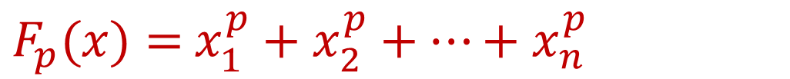
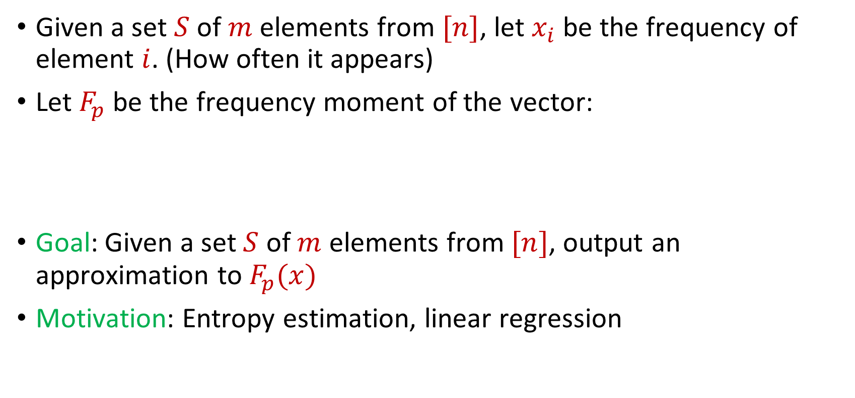
Frequency Moments
Given a set $S$ of $m$ elements from $[n]$, let $x_{i}$ be the frequency of element $i$. (How often it appears)
Let $F_{p}$ be the frequency moment of the vector:
Goal: Given a set $S$ of $m$ elements from $[n]$, output an approximation to $F_{p}(x)$
Motivation: Entropy estimation, linear regression
$F_{p}(x)=$ $x_{1}^{p}+x_{2}^{p}+…+x_{n}^{p}$

Slide 4
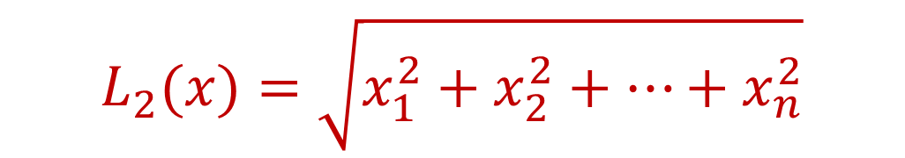
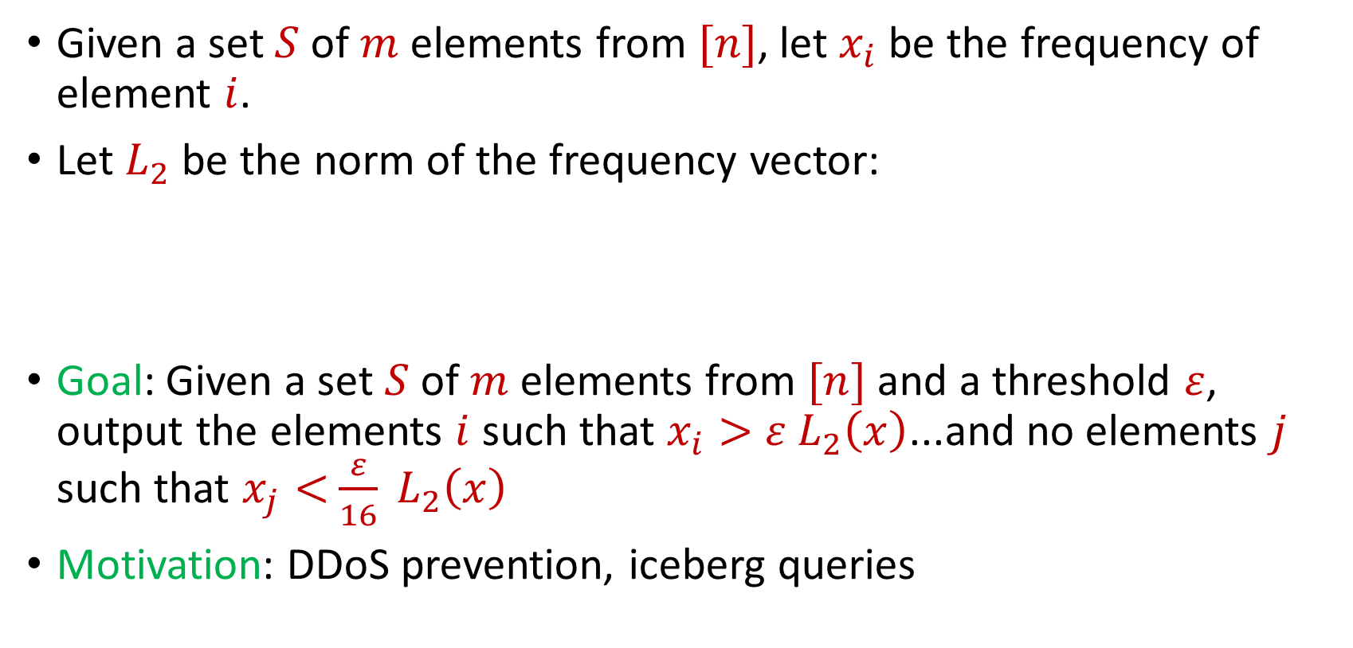
Heavy-Hitters
Given a set $S$ of $m$ elements from $[n]$, let $x_{i}$ be the frequency of element $i$.
Let $L_{2}$ be the norm of the frequency vector:
Goal: Given a set $S$ of $m$ elements from $[n]$ and a threshold $ε$, output the elements $i$ such that $x_{i}>$ $ε L_{2}\left(x\right)$...and no elements $j$ such that $x_{j}<$ $\frac{ε}{16} L_{2}\left(x\right)$
Motivation: DDoS prevention, iceberg queries
$$L_{2}(x)=\sqrt{x_{1}^{2}+x_{2}^{2}+…+x_{n}^{2}}$$

Slide 5
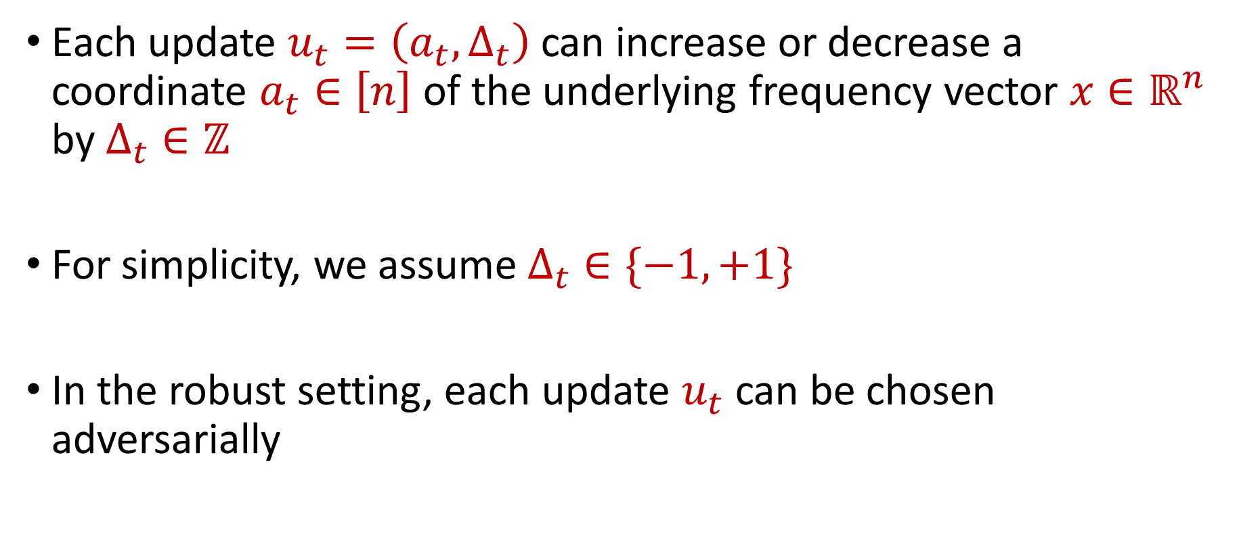
Insertion-Deletion Streams
Each update $u_{t}=\left(a_{t},Δ_{t}\right)$ can increase or decrease a coordinate $a_{t}∈\left[n\right]$ of the underlying frequency vector $x∈ℝ^{n}$ by $Δ_{t}∈ℤ$
For simplicity, we assume $Δ_{t}∈\{−1,+1\}$
In the robust setting, each update $u_{t}$ can be chosen adversarially

Slide 6
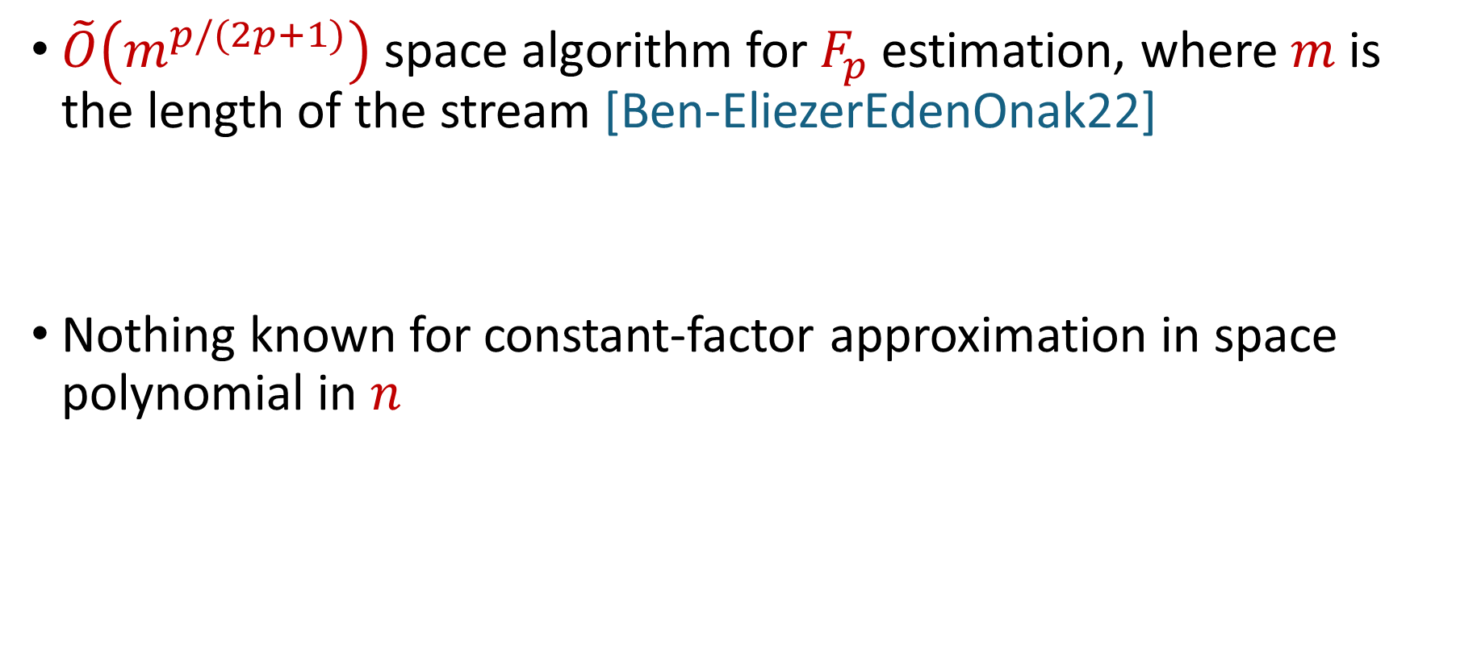
Insertion-Deletion Streams
$\tilde{O}\left(m^{p/(2p+1)}\right)$ space algorithm for $F_{p}$estimation, where $m$is the length of the stream [Ben-EliezerEdenOnak22]
Nothing known for constant-factor approximation in space polynomial in $n$

Slide 7
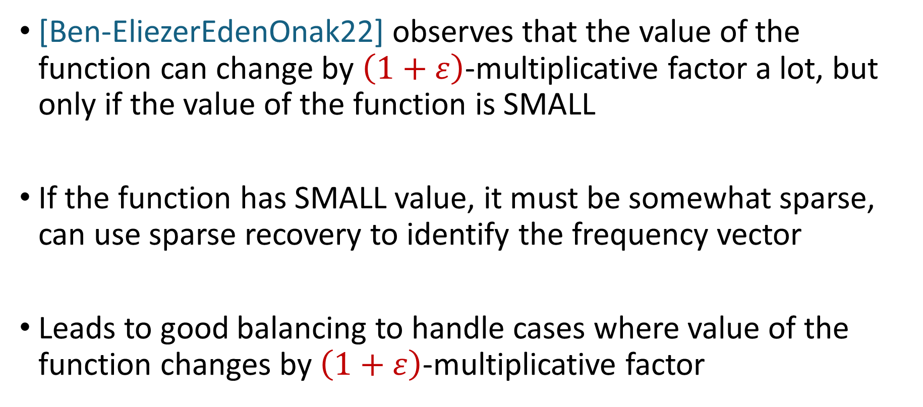
Dense-Sparse Tradeoffs
[Ben-EliezerEdenOnak22] observes that the value of the function can change by $\left(1+ε\right)$-multiplicative factor a lot, but only if the value of the function is SMALL
If the function has SMALL value, it must be somewhat sparse, can use sparse recovery to identify the frequency vector
Leads to good balancing to handle cases where value of the function changes by $\left(1+ε\right)$-multiplicative factor

Slide 8
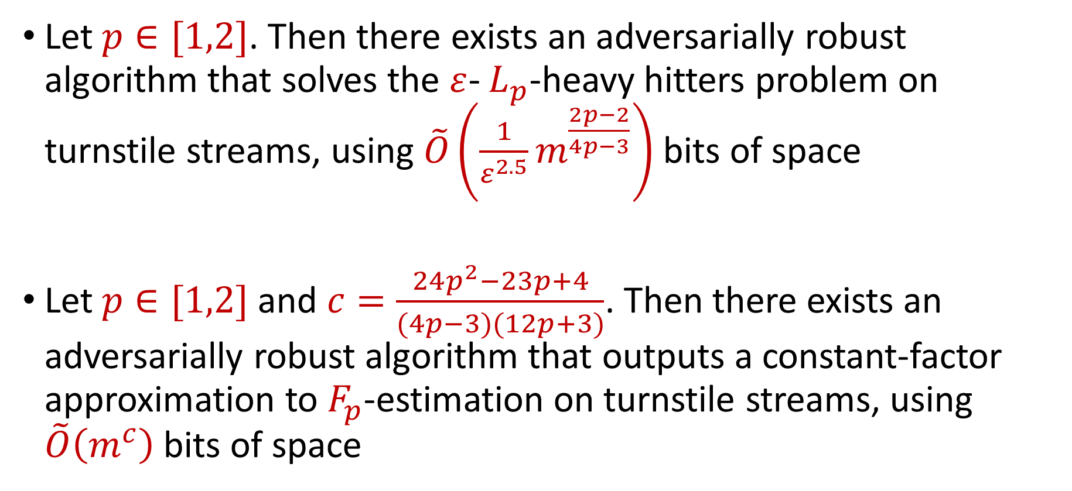
Our Results
Let $p∈[1,2]$. Then there exists an adversarially robust algorithm that solves the $ε$- $L_{p}$-heavy hitters problem on turnstile streams, using $\tilde{O}\left(\frac{1}{ε^{2.5}}m^{\frac{2p−2}{4p−3}}\right)$ bits of space
Let $p∈[1,2]$ and $c=\frac{24p^{2}−23p+4}{(4p−3)(12p+3)}$. Then there exists an adversarially robust algorithm that outputs a constant-factor approximation to $F_{p}$-estimation on turnstile streams, using $\tilde{O}\left(m^{c}\right)$ bits of space

